Slide 1
Entrepreneurship BS-CS – 2022 – Spring Semester
Salmaan Rahman
Lecture 2
Entrepreneurs, Creativity and Innovation

Slide 2
Why do people go into business?
To increase income
Job salaries are fixed and depend on market dynamics (supply and demand)
The richest people in the world are businesspeople
To have an additional source of income
Working two full time jobs is very difficult
Having a side business (run by self or employees) works better
To be your own boss
Independence
Job security
Job security is no longer guaranteed in a rapidly changing world. Owning your own business frees you from corporate decisions (layoffs etc)
To do what interests you
Hobby, or interests that earn you in income
To monetize your specialty and better utilization of skills
Specialized industry experience, knowledge
To meet a need in the market – to seize an opportunity
To help others – social entrepreneurship
It’s the only option (personal circumstances)
Lack of formal education, lack of jobs, tradition (following footsteps)

Slide 3
Worst reasons to start your own business:
Hate your job/boss/corporate culture
Works only if you replace job with a viable alternative
Going after the money/status
Successful entrepreneurs actually rate wealth and status low on the list of motivations
To work less
Most businesses require a lot of hard work and constant supervision to become successful
Increased flexibility
While running some types of businesses (e.g. seasonal) offer more off time, they also increase insecurity which means you have to be ready to take every opportunity as it presents itself
You only want to answer to yourself
Running a business means taking responsibility for others (employees) and being accountable to others (investors, relatives, etc)
To be famous
Status and position is never guaranteed.

Slide 4
Entrepreneurship vs. SBO
Is there a difference between entrepreneurs and small business owners?
The words are often used interchangeably and many aspects are similar
However. . .
Small business owners usually do not engage in new or innovative practices
Usually expect stable sales, predictable profits, and growth, and a non-aggressive approach.
Small business owners may be considered as managers of business rather than entrepreneurs.

Slide 5
Brief history of Entrepreneurs
Earliest usage of the word – Marco Polo
In the earliest days, the risk was mainly in whether or not you made a profit in government contracts
In the 18th century, entrepreneurs were often inventors who used capital provided by others
By the 19th century, entrepreneurs and managers were more or less used identically
Most entrepreneurs were taking existing practices and giving them a modern twist to amass great wealth.
By the 20th century, the definition of “entrepreneur” become more specific as “innovator”

Slide 6
Who are Entrepreneurs? And how do they fit into the business world?
Loan word from French – “entreprendre” – to undertake
Related words: enterprise
An undertaking, especially one of some scope, complication, and risk.
A business organization
Willingness to undertake new ventures; initiative
Entrepreneur: “A person who organizes, operates, and assumes the risk for a business venture”

Slide 7
Who are entrepreneurs?
Classically, entrepreneurs are those people who are willing– or able – to take a creative idea and transform it into a commercially viable business.
Entrepreneurship is a cohesive process involving creativity, innovation, risk taking, and planning.

Slide 8
Some facts about entrepreneurship
All economies are based upon entrepreneurship
Entrepreneurship has a somewhat paradoxical relationship with the economy – when the economy takes a downturn, its usually entrepreneurship that brings it back
Entrepreneurs are individuals who see opportunity where others see chaos and confusion
They are often aggressive catalysts for change
They often challenge and break barriers.

Slide 9
Entrepreneurial Ventures
Usually involves some degree of innovation, the potential for higher profitability, and much more rapid growth
And naturally, much higher risk
Entrepreneurs usually have a different perspective than SBO’s
Might seek rapid growth, immediate profits, or even the sale of their business for large capital gains.
Entrepreneurship studies often focus on the particular type of growth associated with innovation and change

Slide 10
Entrepreneurship
Is more than the mere creation of a business
Often characterized by:
Seeking opportunities
14% of entrepreneurs report that their product has no competitor
Taking risks beyond security
Having the tenacity or persistence to push an idea through barriers to reality
Entrepreneurship
can occur within an organization (intrapreneurship)
be for profit or non-profit
Be unrelated to business entirely (social entrepreneurs)

Slide 11
Modern day:
In almost all definitions of entrepreneurship, there is agreement that we are talking about a kind of behavior that includes:
Initiative – taking that first step
Organizing and reorganizing of social and economic mechanisms to turn the sources and situations to practical (applicable) account
The acceptance of higher risk and failure than SBOs

Slide 12
Entrepreneurship Four aspects
Four basic aspects of being an entrepreneur regardless of the field:
Entrepreneurship involves the creation process
The creation has to have value to both the entrepreneur and the audience for whom it is developed (the market, society or whoever it impacts the most)
Devotion of time and effort
It always takes a significant amount of time and effort to create something new and make it operational
Assuming certain risks
Usually financial, psychological, social
Rewards
Entrepreneurs classify their rewards in the following order:
Independence
Personal satisfaction

Slide 13
Entrepreneurs
Defining the entrepreneurial “mindset” can be difficult, but some research has been devoted to it
Certain characteristics can be developed, others are inborn
Studies in the USA suggest that this generation (18-40) might be the most entrepreneurial generation since the industrial revolution
Almost 6 million young people (<34) are actively trying to start their own business
1/3 under the age of 30
More than 60% of 18-29 y.o. say they want to own their own business.

Slide 14
Common Characteristics 11 characteristics as defined by John Kao
Total commitment, determination and perseverance
Drive to achieve and grow
Opportunity and goal orientation
Taking initiative and personal responsibility
Persistent problem solving
Realism and a sense of humor
Seeking and using feedback
Internal locus of control
Calculated risk taking and risk seeking
Low need for status and power
Integrity and reliability

Slide 15
Entrepreneurs are. . .
Resourceful
Creative
Visionary
Independent thinking
Hard working
Optimistic
Innovative
Risk taking
Leaders

Slide 16
Entrepreneurship
Entrepreneurship thus becomes a function of the entrepreneurial mind, and is the interaction of the following skills:
Inner control
Planning
Goal setting
Risk taking*
Innovation
Reality perception
Use of feedback
Decision making
independence

Slide 17
Entrepreneurial behavior
Commitment, determination, perseverance
Successful entrepreneurs often face many obstacles and setbacks, which may be both internal and external
Investors might measure the above in terms of willingness to mortgage houses, sacrifice time, and reduce standard of living
Drive to achieve:
Entrepreneurs are often internally driven by a strong desire to compete, to excel against internal standards and to meet goals
Goal orientation allows them to define priorities and focus energy
High achievers tend to be moderate risk takers – risks are often assessed, solutions are determined to lower risk, and then they proceed
Opportunity orientation:
They tend to focus on opportunity rather than resources, structure and strategy

Slide 18
Entrepreneurial behavior (cont)
Problem solving
Entrepreneurs are usually not intimidated by difficult situations
The impossible just takes a little longer!
However, entrepreneurs give up more often than others if the problem is deemed truly unsolvable
Realism
Internal locus of control
Entrepreneurs tend to believe in themselves, rather than depending on fate, luck or other external forces
Entrepreneurs also tend to take responsibility
Vision
Starting with a strong vision of what they want to do and achieve

Slide 19
Entrepreneurs and Creativity:
Entrepreneurs blend imaginative and creative thinking with a systematic, logical process ability
This allows them to see opportunities to fill needs and wants and develop plans to fulfill those needs
Systematic thinking allows them to analyze the problem by asking the necessary questions
What is the problem?
Who does it involve?
How does it affect them?
What costs are involved?
Can it be solved?
Would the marketplace pay for such a solution?

Slide 20
Creativity
Creativity: The ability to generate ideas, alternatives, or possibilities that result in solutions, new methods or products
Used in communication, entertainment, business
Everyone is creative to a certain degree
However, the creative process can always be developed further and improved
Two important aspects:
Process
Goal oriented
Designed to determine solutions
People
Adaptors vs. Innovators

Slide 21
Creative People
Some people have a higher aptitude for creativity than others
Environmental factors can play a big role in level of creativity
Degree to which a person has been encouraged to think and act creatively
The creative process has four common steps
Background or knowledge accumulation
The incubation process
The idea experience
Evaluation and implementation

Slide 22
The 4 step creative process
Background or knowledge accumulation
Creativity is usually preceded by investigation and information gathering – related and nonrelated fields
Reading, conversations, absorption of information
This provides a variety of perspectives on the problem
The incubation process
This occurs usually subconsciously, often when disengaged from the problem
Helpful to engage in routine activities, exercise, meditate, relax

Slide 23
The 4 step creative process
The idea experience
Sometimes referred to as the “eureka!” moment
Maybe incremental or sudden
Evaluation and implementation
This is when you evaluate the workability of the idea
Requires a great deal of courage, self-discipline, and perseverance
Helpful to
Educate yourself in the business planning process
Test your ideas with knowledgeable people
Take notice of intuition and feelings
Take advice from others
Learn about policies and procedures that might relate to the idea
View potential problems

Slide 24
Creativity
Stimulators
Barriers
Observation
Reading up widely
Joining professional groups
Traveling
Talking with others
Magazines, journals, news
Develop a library
Carry a notebook and jot down ideas
Allocate time to doing non-related things – e.g exercise
Lack of interest
Lack of knowledge
Discouragement
From self
From others
Assumption that its been tried before
Lack of desire for growth
Lack of time
Fear

Slide 25
Adaptors vs. Innovators
Adaptors
Innovators
Disciplined, precise, methodical
Solve rather than find solutions
Usually work on refining existing practices
Means oriented rather than end oriented
Capable of extended detailed work
Sensitive to group cohesion and cooperation
Approach task from unusual angles
Find solutions rather than solve problems step by step
Question basic assumptions about existing practices
More interested in ends rather than means
Little tolerance for routine work
No need for consensus, insensitive to others

Slide 26
Innovation
One of the key functions of the entrepreneurial process
The means by which an entrepreneur either creates new wealth-producing resources, or endows existing resources with enhanced potential for creating wealth
(Peter F. Druker)
Innovation is the process by which entrepreneurs convert opportunities into marketable ideas, the means by which they become catalysts for change

Slide 27
Innovation
The origin of the idea is often dependant on external observation, while the role of creativity provides the inner solution
Most innovations result from a conscious, purposeful search for new opportunities
Innovation requires extensive research, experience and work
Successful innovators look at numbers, processes and people
Most innovations take place in a single field, one that the innovator is already familiar with
Most innovations are simple and focused, directed towards a specific, clear and carefully designed application
However, the process very often creates now customers and markets

Slide 28
4 Types of innovation
Invention
The creation of a new product, service or process
Novel, untried, may be revolutionary
Extension
Expansion of an existing product, different application of a current idea
Duplication
Replication of an existing idea or product, with an touch of creativity from the innovator that allows the product to be enhanced or gives a competitive advantage
Synthesis
The combination of existing ideas and concepts to provide a new formulation or application

Slide 29
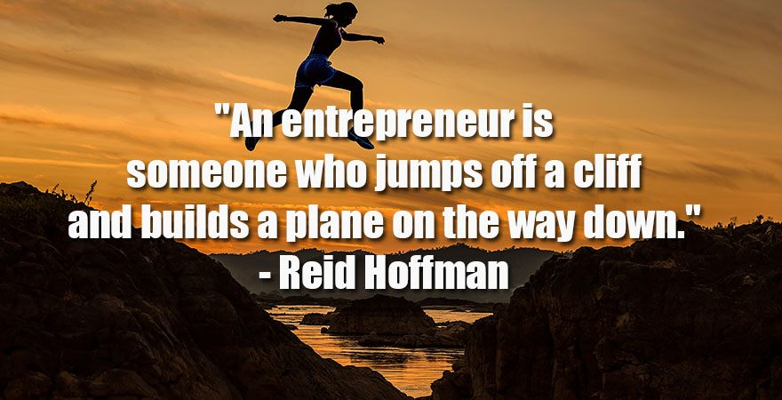

Slide 30
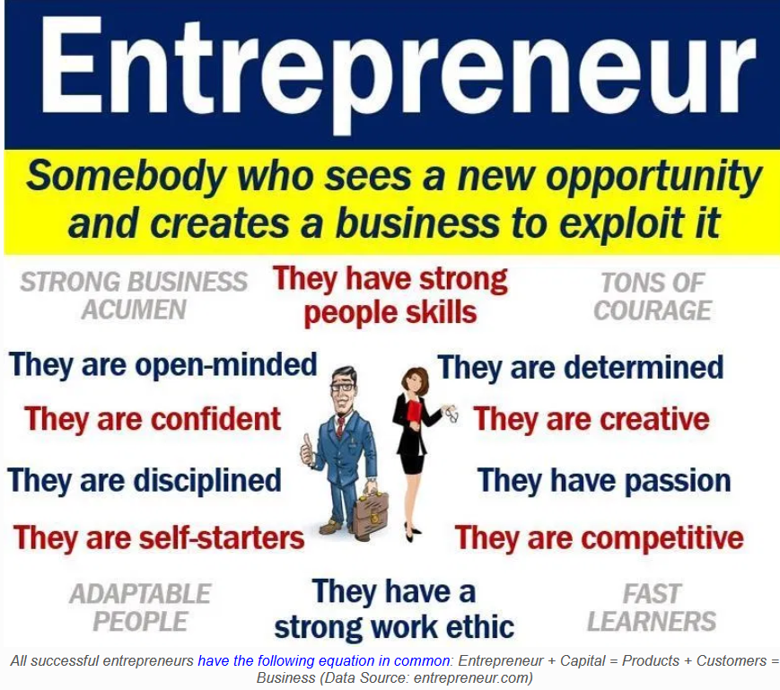

Slide 31
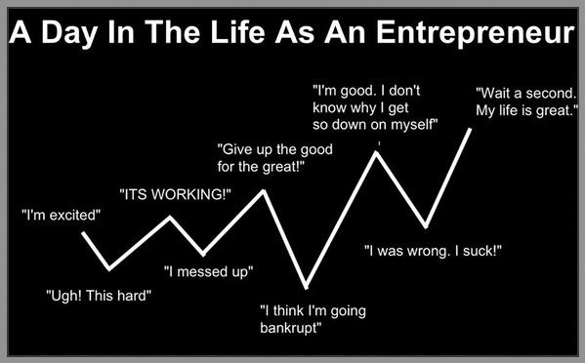

Slide 32


Slide 33
